Slide 1
Virtualization types

Slide 2
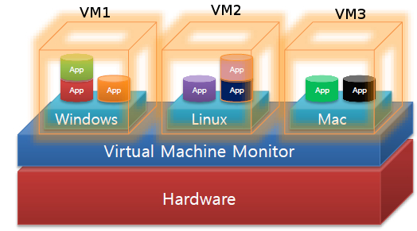
Virtualization
Virtualization is a technology to run multiple virtual machines(VM) on the same hardware
VM is an efficient, isolated duplicate of the real machine
The software layer that creates the virtual environment is called a Virtual Machine Monitor (VMM) or Hypervisor

Slide 3
Types of Hypervisors
VM1
VM1
VM1
App
App
App
App
App
App
Guest OS
Guest OS
Guest OS
Type II Hypervisor
App
App
Type I Hypervisor
Host OS
Hardware
Hardware
baremetal
Eg: Xen, Microkernel based
Hosted Hypervisor
Eg: VMware workstation, Oracle Virtual Box, Microsoft virtual PC

Slide 4



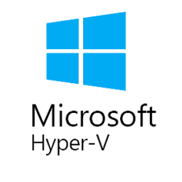
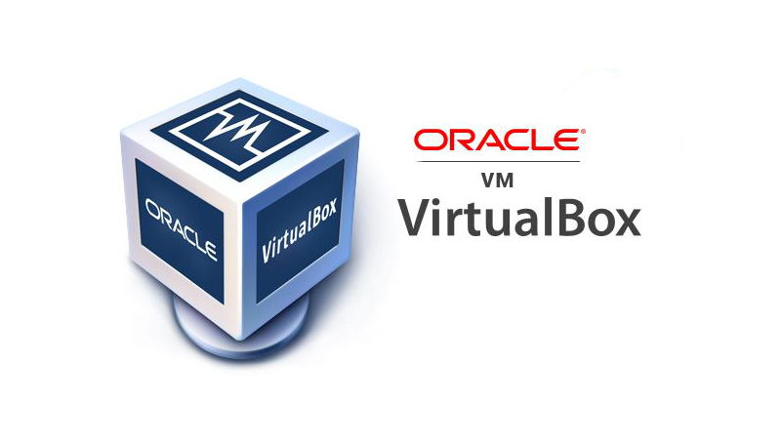
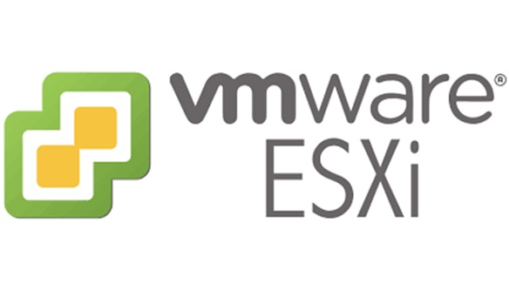

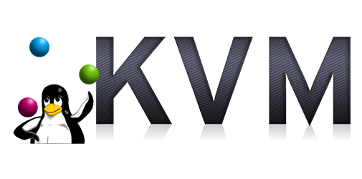
Use case of Virtualization in Enterprise Industry
Server Consolidation
Cloud computing
Virtual desktop infrastructure
Advantages
  Energy savings by consolidation
  High resource utilization
  Low management & maintenance cost
  High level of security

Slide 5

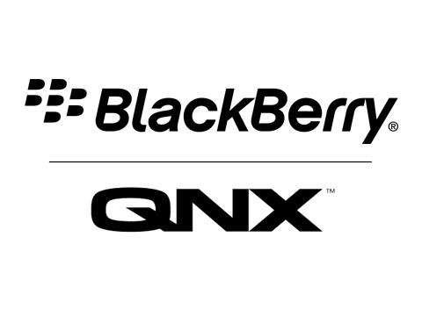




Use Case of Virtualization in Mobile and Embedded Systems
Safe
Security
  Strong isolation between co-located VMs
  Safe from bugs and malicious attacks
Coexistence of Heterogeneous OS
  RTOS + GPOS
  Security-enhanced OS + GPOS
  Business Phone + Personal Phone
VM1
VM2
App
App
App
App
OS
OS
OS
Hypervisor
Hardware
Hardware
Microkernel Based
Hypervisor

Slide 6
Formal Requirements of Virtualization
Characteristics of a VMM are
  Equivalence
  Efficiency
  Resource Control
A VMM can be constructed if the set of sensitive instructions of that computer is a subset of the set of privileged instruction.”
[1] G. J. Popek and R. P. Goldberg, ‘‘Formal requirements for virtualizable third generation architectures,’’ Commun. ACM, vol. 17, no. 7, pp. 412–421, 1974.

Slide 7
Characteristics of VMM
Equivalence
Efficiency
Resource Control
A VMM can be constructed if the set of sensitive instructions of that computer is a subset of the set of privileged instruction.
[1] G. J. Popek and R. P. Goldberg, ‘‘Formal requirements for virtualizable third generation architectures,’’ Commun. ACM, vol. 17, no. 7, pp. 412–421, 1974.

Slide 8
Virtualization Techniques
1. Full virtualization
Binary rewriting
Unmodified guest
QEMU, VMware
2. Paravirtualization
Cooperative virtualization
Modified guest
Xen, Microkernel based
3. Hardware-assisted Full Virtualization
Unmodified guest
Silicon level
KVM, VMware and Xen
VM1
VM2
App
App
VM1
VM2
VM1
VM2
Guest OS
Guest OS
App
App
App
App
Dynamic Binary Translation
Guest OS
Guest OS
Guest OS
Guest OS
Operating System
Hypervisor
Hypervisor
Hardware
Hardware
Hardware
Virtualization Logic

Slide 9
Monolithic vs Microkernel
Application
User
Space
File Systems, VFS
Processes, Scheduling, IPC
Memory Management, address space
Application
UNIX
Server
Device
Driver
File
Server
Networking, Sockets, protocols
Kernel
Space
Address spaces, Threads,
Basic Scheduling, IPC
Device Drivers
Hardware
Hardware
Monolithic OS
Microkernel OS

Slide 10
KVM/QEMU
KVM, add hypervisor capability to Linux, on boards with hardware virtualization Extension.
KVM is implemented as Linux kernel module
QEMU uses KVM when available to virtualize guests at near-native speeds
KVM uses a slightly modified instance of QEMU for emulation
Userspace
Guest VM
QEMU
I/O Emulation
ioctl()
return
VM Entry
VM Exit
/dev/kvm
Linux Kernel Space
KVM Kernel Module
Hardware with Virtualization Technologies

